Slide 1
A Great Place
for Students
Science n Stewardship n Service
2019

Slide 2
GSA is a 22,000-strong, diverse community of member geoscientists from around the world—working in Education, Industry, & Government.

Slide 3
GSA DIVISIONS
Continental Scientific Drilling
Energy Geology
Environmental & Engineering Geology
Geoarchaeology
Geobiology & Geomicrobiology
Geochronology
Geoinformatics & Data Science
Geology & Health
Geology & Society
Geophysics and Geodynamics
Geoscience Education
History & Philosophy of Geology
Hydrogeology
Karst
Limnogeology
Mineralogy, Geochemistry, Petrology, & Volcanology (MGPV)
Planetary Geology
Quaternary Geology & Geomorphology
Sedimentary Geology
Soils and Soil Processes
Structural Geology & Tectonics

Slide 4
GSA serves the profession through
Publishing
Scientific Meetings
Education and Outreach
Public Policy and Government Affairs
Awards and Recognition

Slide 5
GSA’s Vision
To be the premier geological society supporting the global community in scientific discovery, communication, and application of geoscience knowledge.

Slide 6
GSA’s Mission
To advance geoscience research and discovery, service to society, stewardship of Earth, and the geosciences profession.

Slide 7
GSA is leading the way to the FUTURE

Slide 8
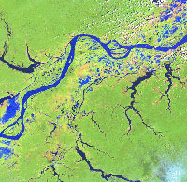
The world depends on the geosciences for expertise in
Energy
Water
Mineral Resources
Waste Disposal
Natural Hazards
and more

Slide 9
The future can be bright—
but society requires another generation of dedicated scientists

Slide 10
How is GSA supporting students?
With
Easy, affordable access to published leading-edge research
Funding for their own research and fieldwork
Opportunities to develop skills in presenting scientific information
Career-building resources and experiences
Ways to make a difference!
Here’s What GSA Offers …

Slide 11
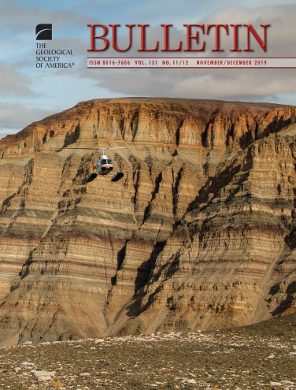
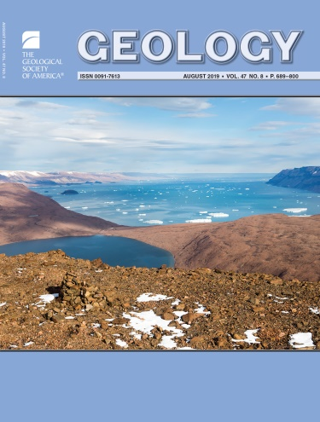
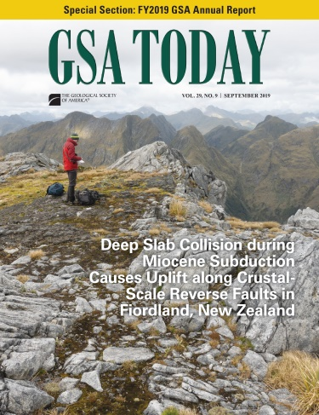
PUBLICATIONS
Print & Online Journals
Geology
GSA Bulletin
Geosphere
GSA Today
Student Members receive FREE online access.

Slide 12
Plus member-only discounts on
Special Papers
Memoirs
Reviews in Engineering Geology
Memorials
Maps & Charts
and more
www.gsapubs.org

Slide 13
SCIENTIFIC MEETINGS
Annual Meeting & Exhibition
(fall)
Student Programs include:
Travel grants
Volunteer opportunities (to offset registration cost)
Formal & informal networking
Short Courses
Student career and mentor programs and social activities
Get your professional feet wet!

Slide 14
Plus
Six Regional Section Meetings (spring)
Northeastern
North Central
Southeastern
South Central
Rocky Mountain
Cordilleran
Section meetings are especially student-friendly and affordable
Present your research
Attend mentoring programs with government and private sector geoscientists
Career workshops
Field trips

Slide 15
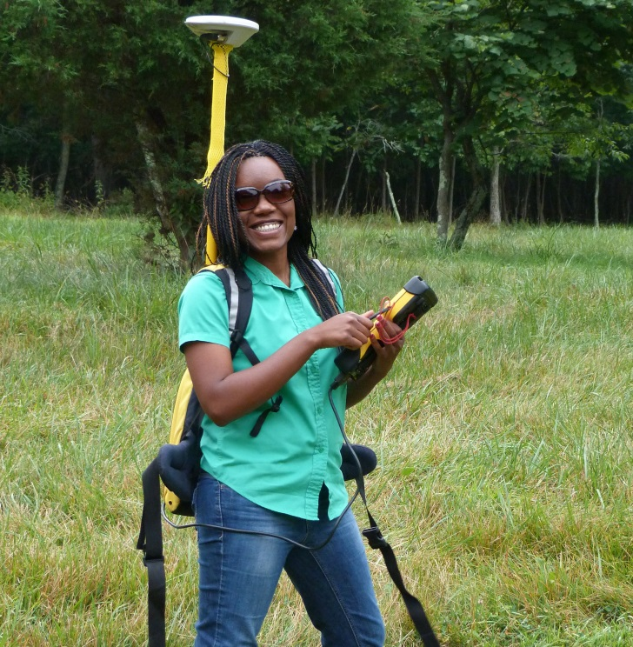
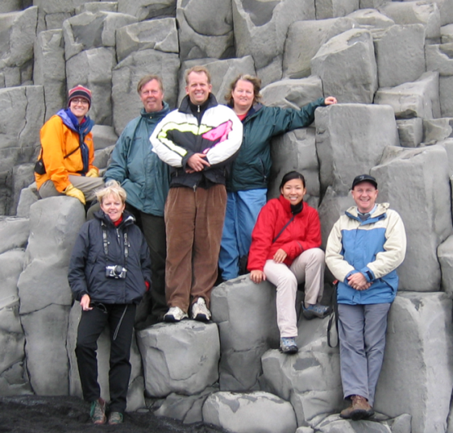
GSA CAREER-BUILDING
PROGRAMS
GeoCorps™ America
Research Grants
Mentoring Programs
On To the Future
GeoCareers
Student Awards (Bighorn and Field Camp Scholarships)
Short Courses
Best Paper / Best Poster / Student Map

Slide 16
Take advantage of all that GSA has to offer.
Join in the 4th Quarter
and get up to 15 months of membership for the price of 12.
Membership is on a calendar year basis.
Student members enjoy a five-year transitional period after graduation before paying full professional dues.

Slide 17
Questions? GSA Sales & Service gsaservice@geosociety.org
+1.888.443.4472 (toll free) or +1.303.357.1000, option 3
Learn more at www.geosociety.org
Apply for Membership Online www.geosociety.org/members

Slide 18
Thank you!

